Slide 1
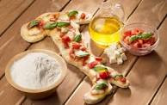
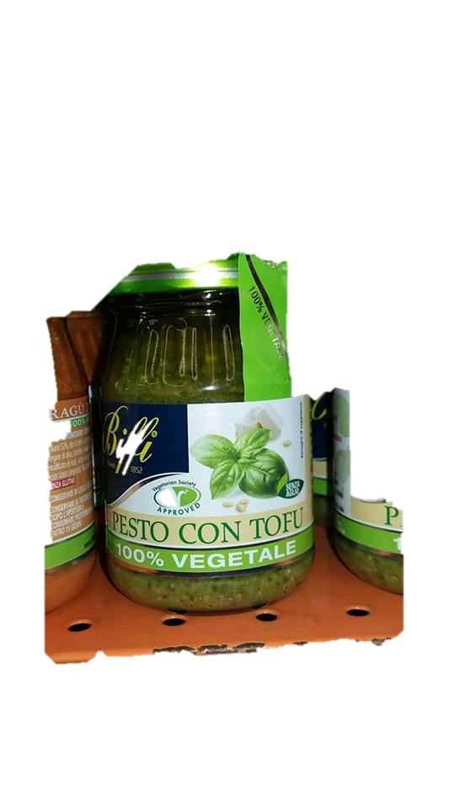
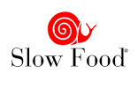
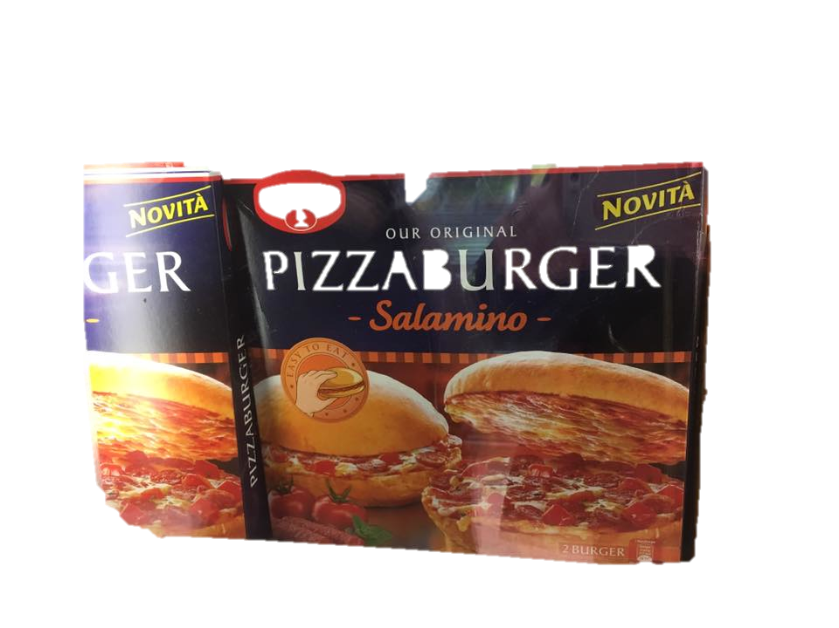
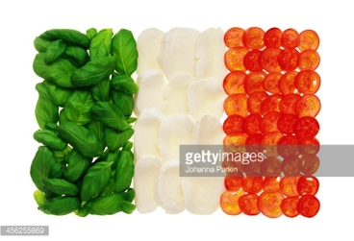
Italian 305
A Taste of Italy

Slide 2
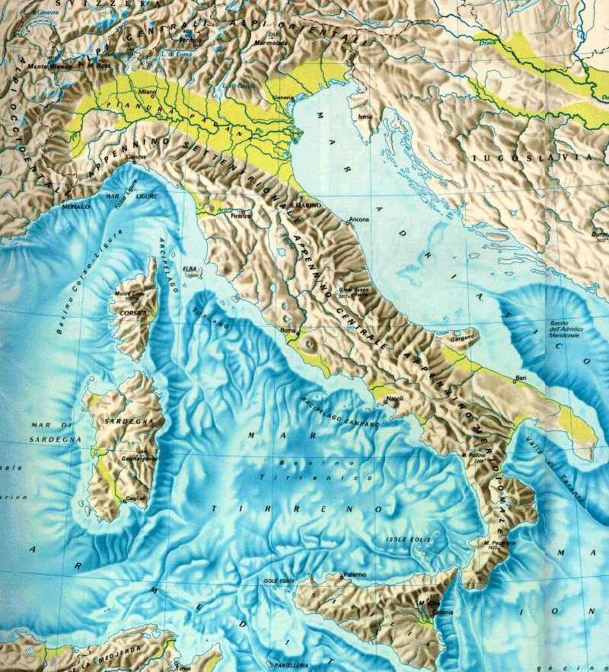
Italian Geography
Peninsula
Length 1185 Km
Two main islands
Two main mountain chains:
Alps
Apennines
One main plain area
Pianura Padana
Po River Valley

Slide 3
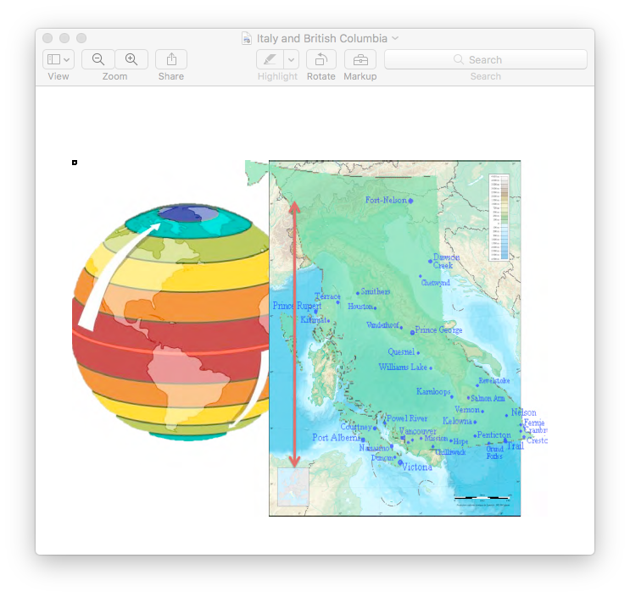
Comparing the size of British Columbia and Italy

Slide 4
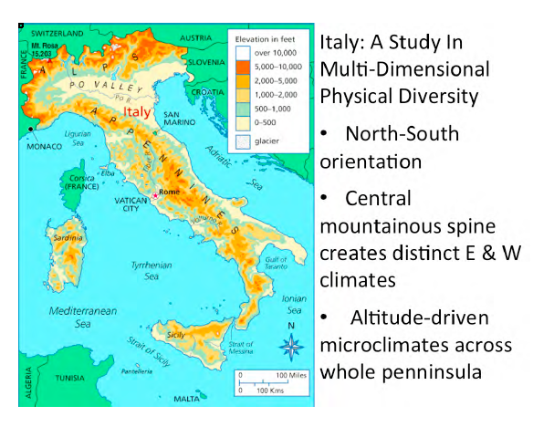
Map of Italy and explanation

Slide 5
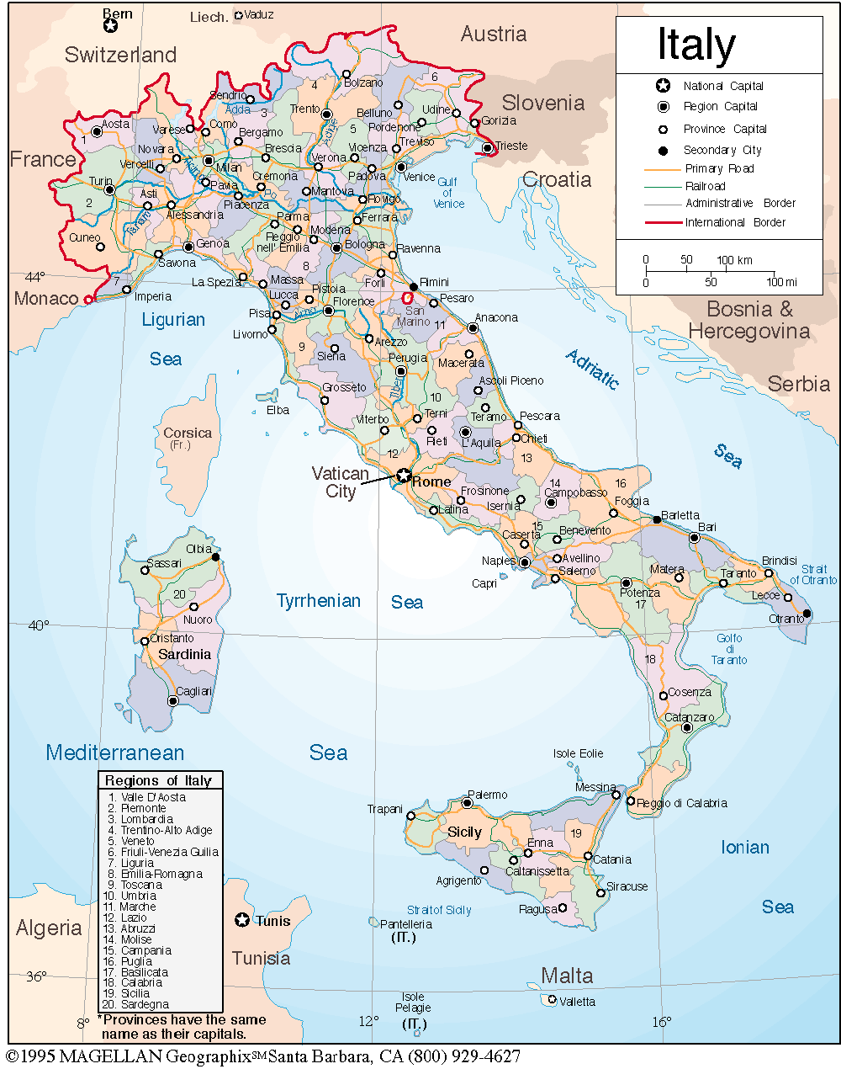
Italian Regions
Valle d'Aosta
Piemonte
Liguria
Lombardia
Trentino-Alto Adige
Veneto
Friuli-Venezia Giulia
Emilia-Romagna
Toscana
Marche
Umbria
Lazio
Abruzzo
Molise
Campania
Basilicata
Puglia
Calabria
Sicilia
Sardegna

Slide 6
What is Italian Food?
What do we talk about when we talk about Italian food?
When did it become popular?
What contributed to its international success?
What is glamorous about Italian Food?
When did Italian food become “Italian”?
When did this identity come into existence?

Slide 7
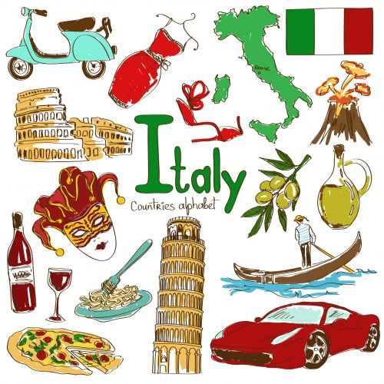
Stereotypes

Slide 8
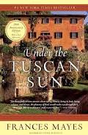
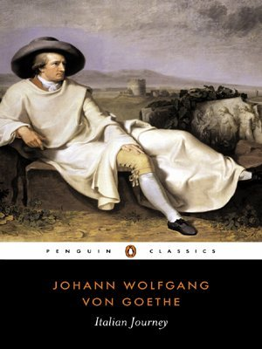
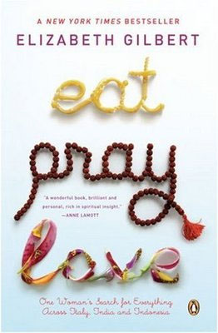
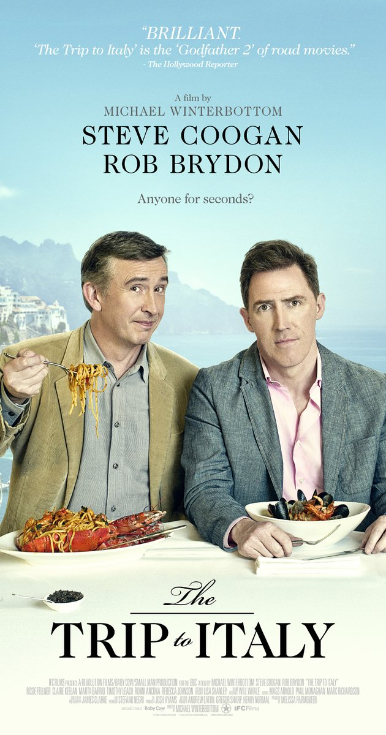
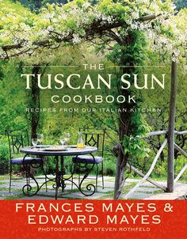
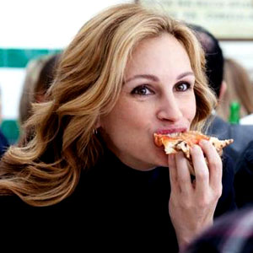
Travellers’ views of Italy

Slide 9
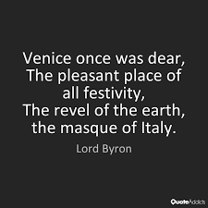
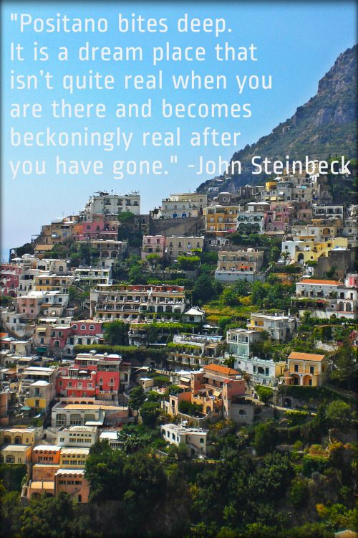
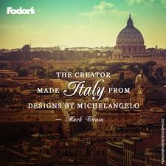
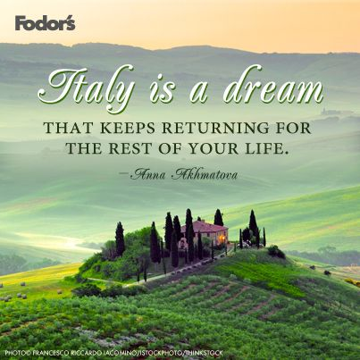
Writers and Italy

Slide 10
Mark Twain’s view of Italian and European Food from A Tramp Abroad (1880)
“A man accustomed to American food and American domestic cookery would not starve to death suddenly in Europe; but I think he would gradually waste away, and eventually die”
“In Europe coffee is an unknown beverage.”
“After a few months’ acquaintance with European ‘coffee,’ one’s mind weakens, and his faith with it, and he begins to wonder if the rich beverage of home, with its clotted layers of yellow cream on top of it is not a mere dream, after all, a thing which never existed.”

Slide 11
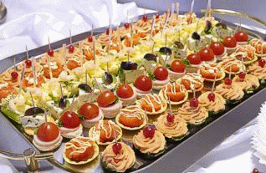
Antipasti a titillating way to start a meal
Contrary to popular belief, an antipasto is not what comes before pasta, but what comes before a meal, un pasto. It is supposed to introduce the main

Slide 12
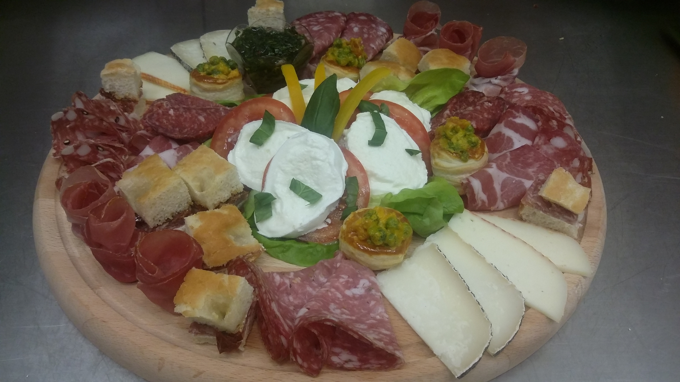
Antipasti freddi
Cold antipastos are the most popular ones. They can be rather simple and effortless to arrange and serve, or more complex and imaginative.

Slide 13
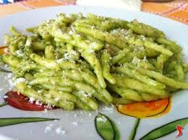
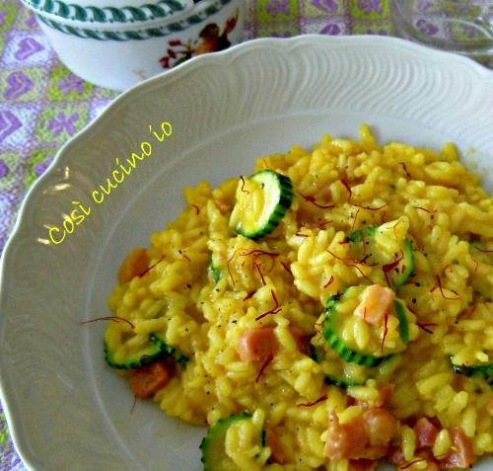
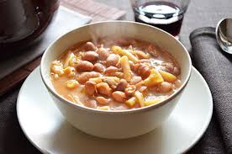
Primi piatti
In spite of their great variety, primi piatti are always starch based and can include pasta, rice, polenta or any kind of soup.

Slide 14
What does pasta stand for? Is pasta a synonym for noodles?
When we talk about pasta, we actually distinguish between pastasciutta i.e. pasta asciutta, dry pasta and pasta in brodo, pasta cooked and served in a broth.
Pasta comes in many different shapes, not only as a flat stripe. Although this kind of pasta was the easiest to create.
For an Italian the word “noodle” means spaghetti, tagliatelle, fetuccine, not penne, bowties, or any other kind of dried pasta.

Slide 15
Evolution of pasta
Lasagne or noodles? Which comes first?
Even in Roman times there are references to lasagne. Noodles were eventually produced by cutting lasagnas in small strips of different width and length.
With the technology to make dried pasta, it could be prepared and stored for a long time and thus it could be traded.
Why would people decide to serve pasta in a broth? Because it was more economical and nutritional. Nothing got wasted. It did not have to be eaten immediately, the way drained pasta has to.

Slide 16
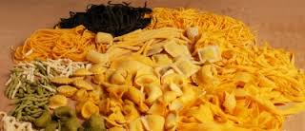
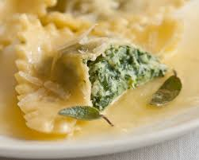
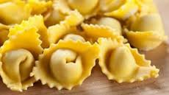
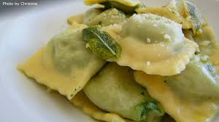
Pasta
Dried pasta made only of wheat semolina flour and water
Egg pasta, which is called pasta fresca, fresh pasta (traditionally home made)
Pasta ripiena, stuffed pasta: ravioli, tortellini, pansotti, etc

Slide 17
Secondi
Proteins
Meat
Fish
Eggs

Slide 18
Dolci
Great regional differences
Naples: Sfogliatelle
Sicily: Cannoli
Tiramisù
and many
more

Slide 19
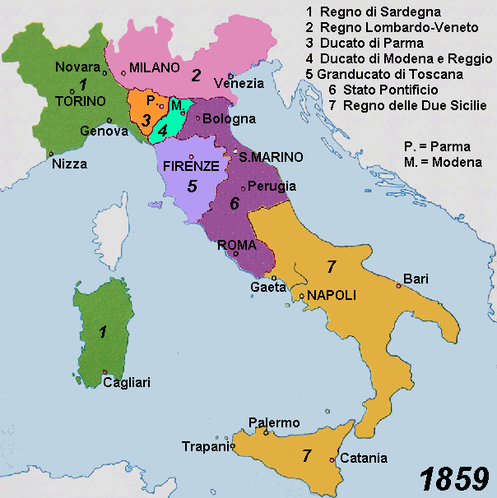
The making of a nation
Political divisions
Kingdom of
Sardinia
2. Lombard-Veneto
3. Duchy of Parma
4. Duchy of Modena
5. Grand Duchy of
Tuscany
6. Pontifical State
7. Kingdom of the Two
Sicilies

Slide 20
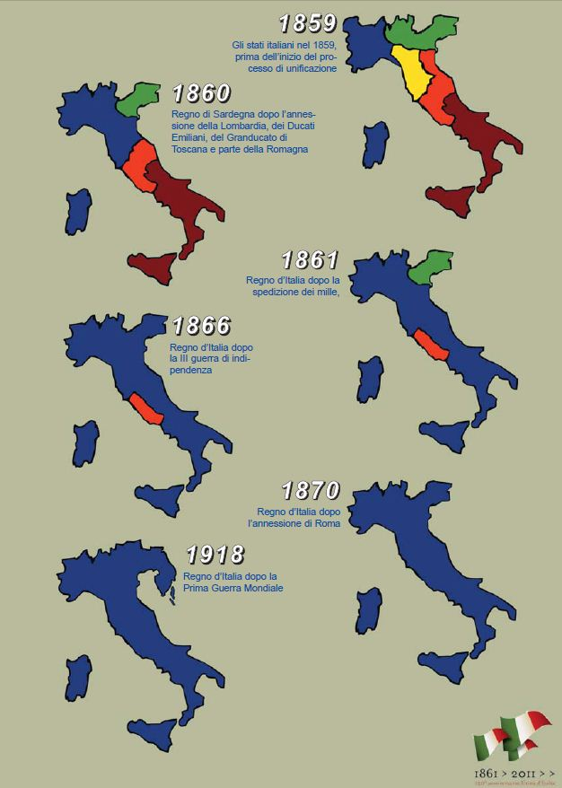
Unification

Slide 21
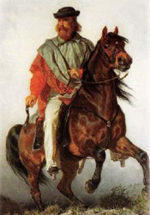
1861 official date of the unification
Garibaldi and the expedition of the 1000
The red shirts
1870 Rome becomes part of Italy
What are the challenges of the new
Nation state?
Here is the initial question that Massimo Montanari attempts to answer in his book

Slide 22
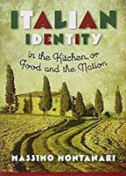
Italian Identity in the Kitchen or Food and the Nation

Slide 23
The Italian Flag
What is the origin of the Italian Flag, the Tricolore?
It is actually modeled after the French flag
Green represents hope and green pastures
White represents faith and the Alpine glaciers
Red represents the blood of those who gave their life for freedom and unification of the country

Slide 24
Massimo D’Azeglio
The making of the Italian people
Weak sense of national identity
Linguistic differences
An ongoing problem
Remember Maurizio’s lecture Sardinians, not Italian
Does an Italian cuisine exist?

Slide 25
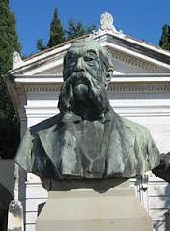
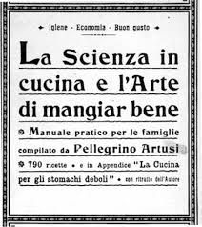
Pellegrino Artusi
1891 La scienza in cucina o l’arte di
mangiar bene Science in the Kitchen
Readership of the book
Emerging middle class
Illiteracy rate in 1861 78%
91% in Sardinia, 57%Piedmont
60% Lombardy
Female illiteracy rate was 84%
1901 female illiteracy was 60%

